Slide 1
WELL-BEING
AND HEALTH
Satakunta

Slide 2
1
5
High-Quality Care
Private Service Providers
Yyteri – the Full Experience
Home of Yoga
Crossfit
The Finnish Baseball Success Story
  Frontrunner in Superpesis
2
6
3
4

Slide 3

High-Quality
Care
The Satakunta Hospital District provides high-quality services to the residents of its 17 member municipalities.
Its hospitals are located in Pori, Rauma and Harjavalta.
About 3,700 people work for the Satakunta Hospital District.
Notes:
https://www.satasairaala.fi/
https://www.satasairaala.fi/satasairaala/satakunnan-sairaanhoitopiirin-kuntayhtyma

Slide 4


Private Service Providers
Mehiläinen and Terveystalo, Finland's largest private providers of social and health services, both operate in Satakunta.
Both are also major providers of occupational health services.
Kankaanpää, Rauma & Pori
Several offices in Satakunta
Notes:
https://www.mehilainen.fi/
https://www.terveystalo.com/

Slide 5

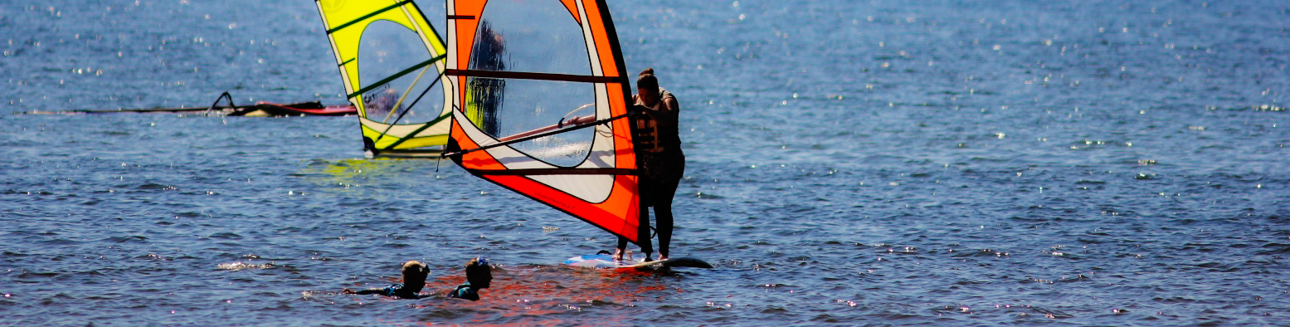
Yyteri – the Full Experience
In Yyteri you can enjoy more than six kilometers of sandy beach, countless hiking trails and various activities from golf to paddling.
Yyteri is known as the Finnish surfing capital and one of the best surfing beaches in Finland.
It was in Yyteri the Finnish surfing
culture started off in the 1990s.
Visit Pori / Toni Mailanen

Slide 6

Home of Yoga
Finland’s FIRST
yoga school focusing exclusively on ashtanga yoga was founded in Pori in 1997.
Today, there are several different possibilities to practice yoga in Satakunta.
Notes:
https://mattirautaniemi.files.wordpress.com/2012/08/historia.pdf

Slide 7


CrossFit
CrossFit Pori is the
OLDEST
CrossFit hall in Finland.
The FIRST
Finnish CrossFit Championship competition was organized in Pori in 2012.

Slide 8
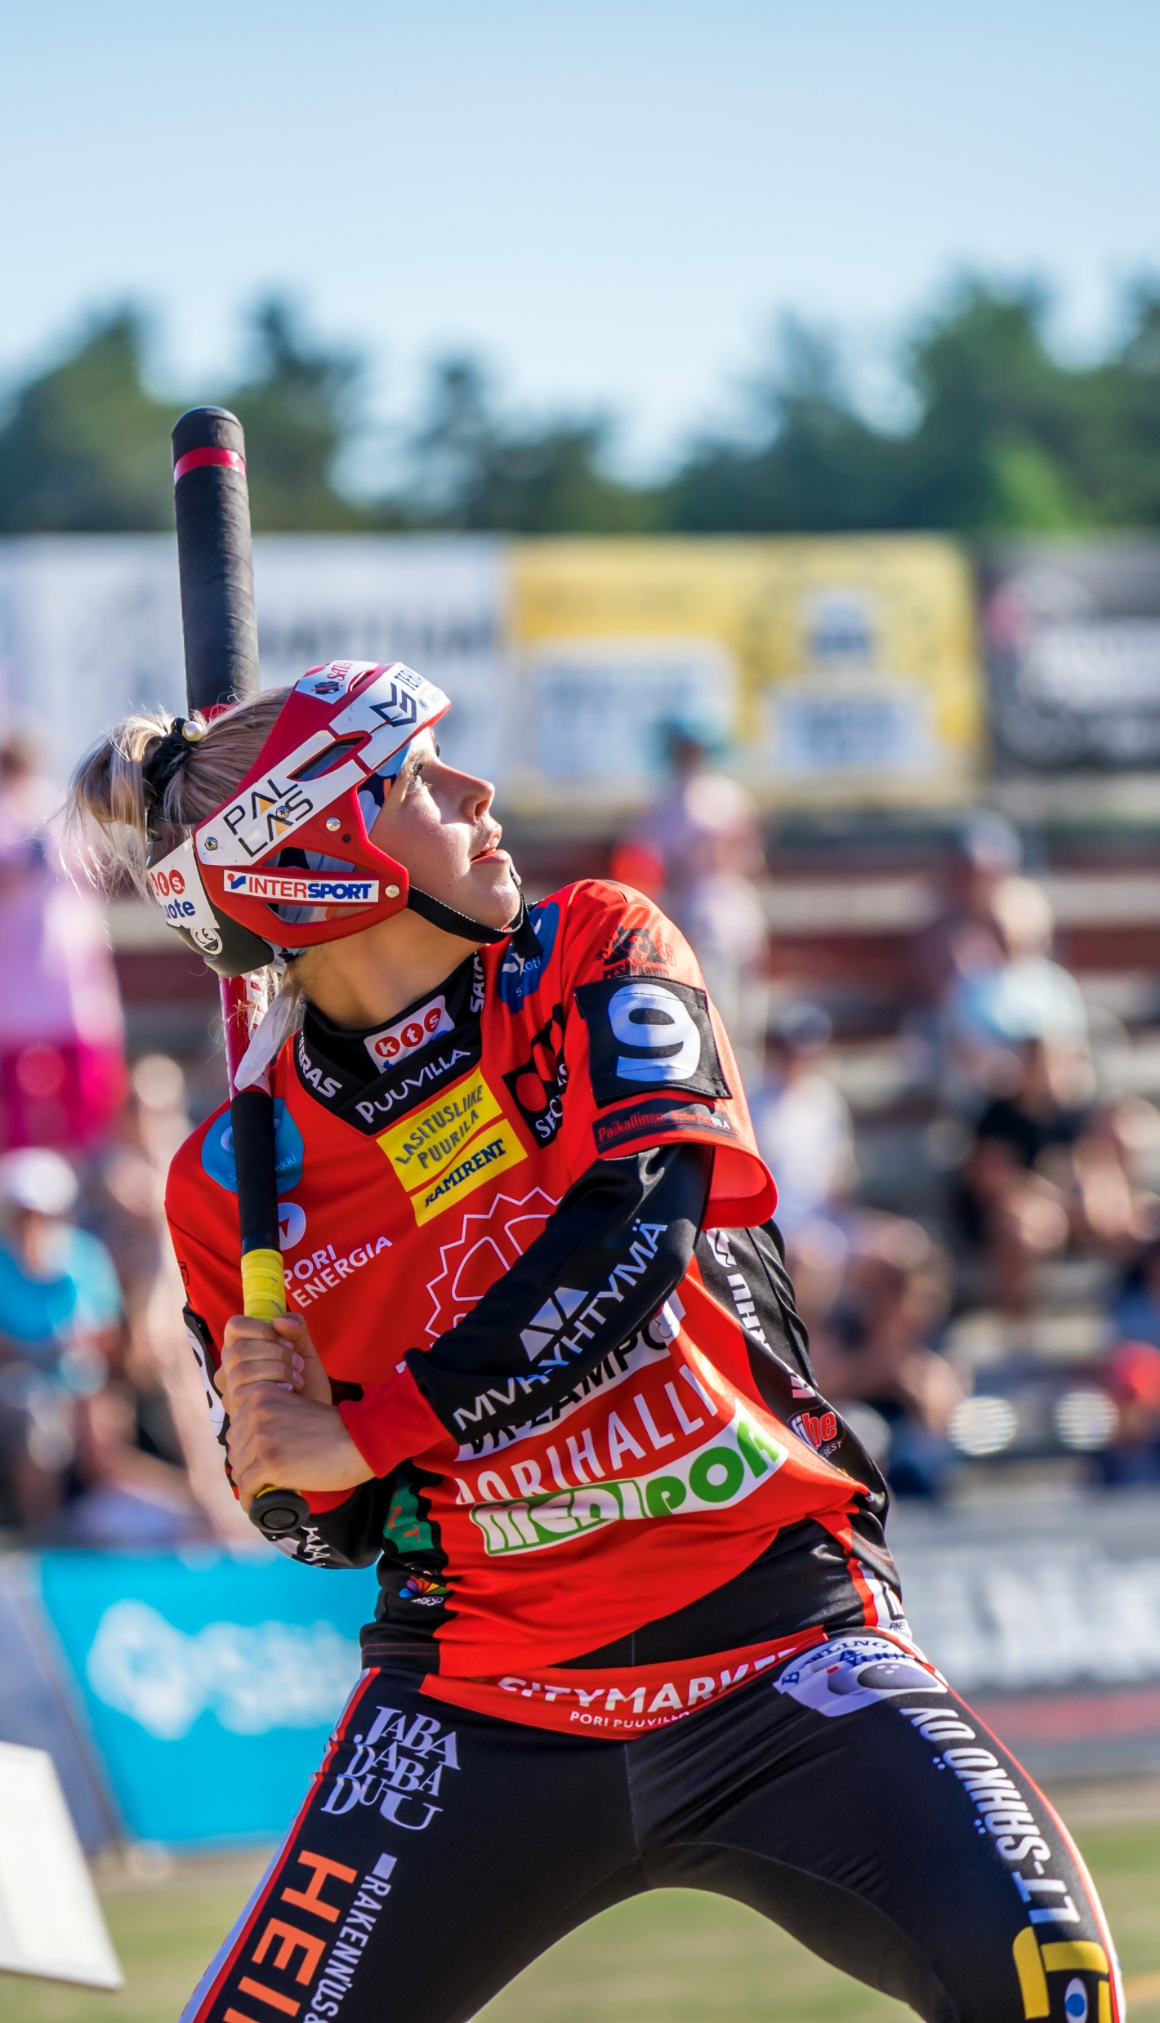

The Finnish Baseball Success Story
Huippupesis / Topi-Aleksi Lohiranta
Porin Pesäkarhut is a baseball club from Pori, and its women's team has played in the Finnish main series Superpesis continuously since 1996.
&
The MOST POPULAR team in women’s baseball in Finland
The LARGEST baseball club in Finland in 2017, 2018 and 2019
Notes:
https://pesakarhut.fi/

Slide 9



Frontrunner in Superpesis
16 medals
during the past 20 years
– 1 gold, 6 silver ja 9 bronze medals
2004
onwards in the top 4 teams
2002
Championship
Notes:
https://pesakarhut.fi/

